Slide 1


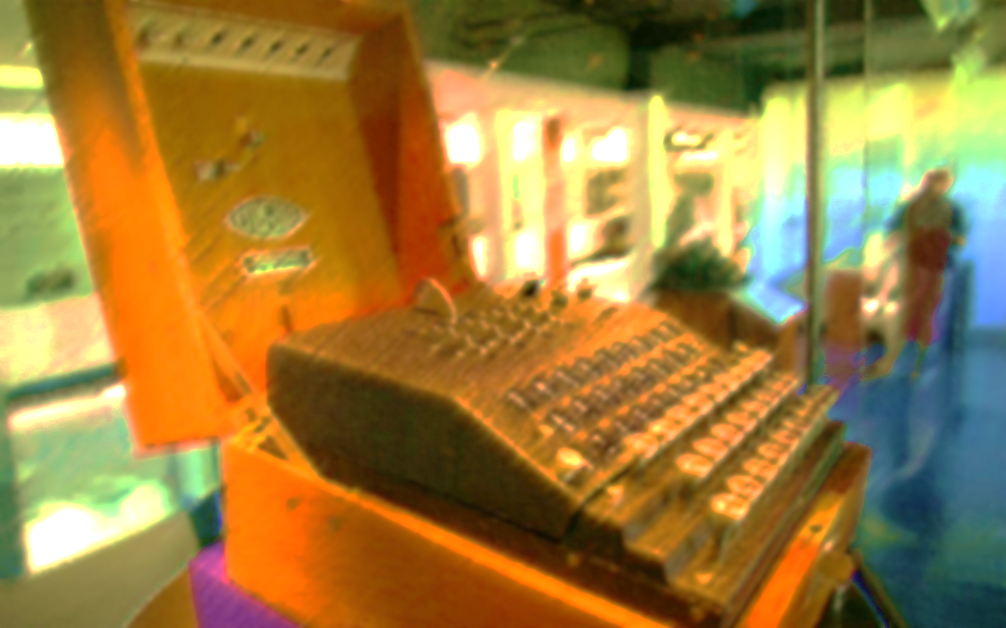
Pulsed Radar
Thanks
Types
About
History
Title
Applications
Operations
DESIGNED BY TUXEDOS
Presenter Noureldin

Slide 2
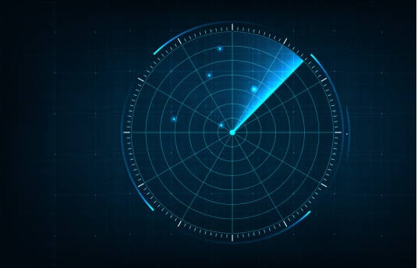

Pulsed Radar
About
Title
Thanks
Types
History
Applications
Operations

Slide 3
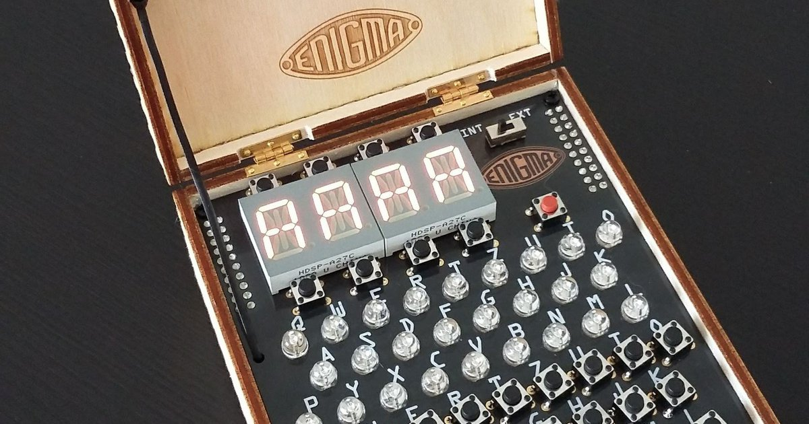



MESSAGE FROM
MESSAGE FROM
MESSAGE FROM
Title
Thanks
About
Types
History
Operations
Applications
Ahmed Adel
Omar
Noureldin
Tuxedos Reporter
Tuxedos Visualizer
Tuxedos Coder
We have been working over
this project seeking your welfare
and we would be grateful
to know your feedback.
The Best way to understand
others is through communication!
Don’t Waste your Time,
We are here to help!

Slide 4

1888
1904
1922
1930
1942
2
3
4
5
1
Hertz was eager to experiment maxwell’s theory stating that radio waves could be reflected from metallic objects and refracted by dielectric mediums
World War II
Aircraft detecting radars that listen for acoustic noise from aircraft engines ignition were developed
Title
Types
The german engineer Christiam Hulsmeyer applied this concepts to build an obstacle detector and ship navigation device,
History
Operation
L.A.Hyland observed a fluctuation in the received signal when an aircraft flew through transmitted signal.
Long ranged military bombers carrying large payloads were developed.
About
Application
Thanks
Yet NOBODY CARED!!
Yet no military or economic need for the radar existed!!
Yet NOBODY CARED!!
The need existed!!
Radar is now used in all countries!

Slide 5
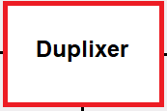
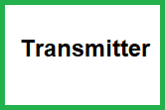
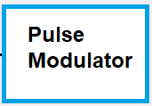


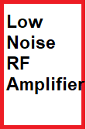

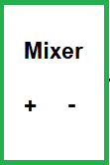
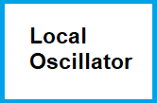
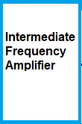
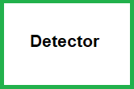
So How Does a pulse radar work?
Antenna
Thanks
Types
Title
About
History
Applications
Operations

Slide 6
So How Does a pulse radar work?
Pulse Modulator:
Produces a modulated pulse train signal
Transmitter:
Transmits the pulse modulated signal
Connects the antenna to both the receiver and the transmitter C
Duplexer:
Amplifies the weak RF signal received by the antenna
Low Noise RF Amplifier:
Thanks
Types
Title
Operations
About
Applications
History
Local Oscillator:
Generates a carrier wave with specific frequency, and passes it the mixer.
Mixer:
Modulates the signal produced from the pulse modulator with with a carrier wave to transmit the signal
IF Amplifier:
Amplifies the intermediate frequency signal which improves it.
Detector:
Demodulates the signal acting as a “Receiver”

Slide 7
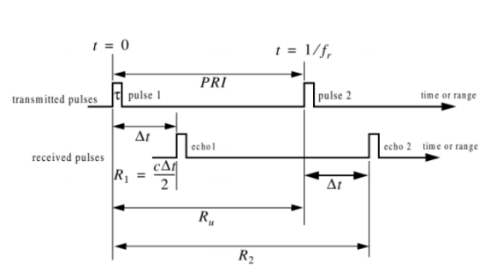
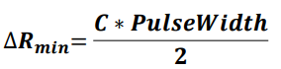
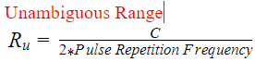
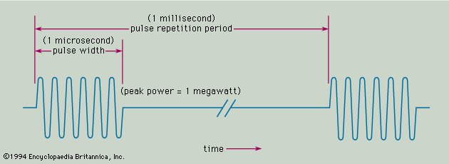
Range ambiguity resolution is a technique used with medium Pulse repetition frequency radar to obtain range information for distances that exceed the distance between transmit pulses
Thanks
Types
Range Resolution ability of a radar system to distinguish between two or more targets on same angle but different Ranges. Rmin is minimum needed distance for distinguishing
Title
Operations
About
Applications
History
This image shows the pulse width, and the pulse repetition frequency

Slide 8

Different types of radar:
According to the setting in which the radar is used different types of pulse replication are implemented for the radar
Thanks
Types
Title
Operation
About
Applications
History
1
2
3
Low Pulse Replication
Medium Pulse Replication
High Pulse Replication

Slide 9
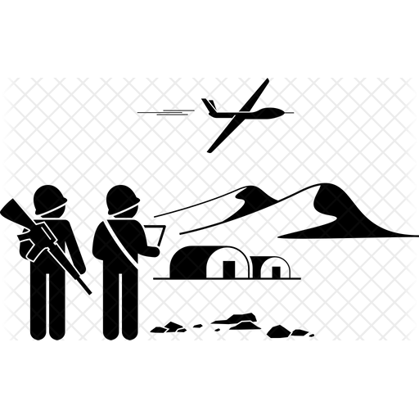



Applications for pulse radar
military surveillance
Thanks
air traffic control
Types
Title
Applications
Operations
About
History
weather observation
Some text goes here
Some text goes here

Slide 10
Thank you for
your attention
Title
Thanks
Types
About
History
Applications
Operations
:)

